Slide 1
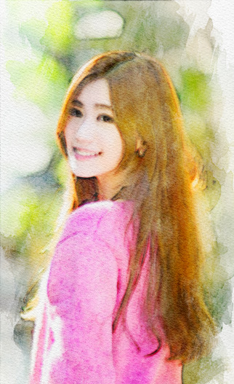
水彩画風に
https://tech-lagoon.com/imagechef/image-to-watercolor.html

